Slide 1
SENTIMENT ANALYSIS AND RECOMMENDATION SYSTEM BASED ON HOTEL REVIEWS
By:
Sri Harsha Vanga
Jainul Patel
Manasa Yedire
Guided By:
Professor Magdalini Eirinaki

Slide 2
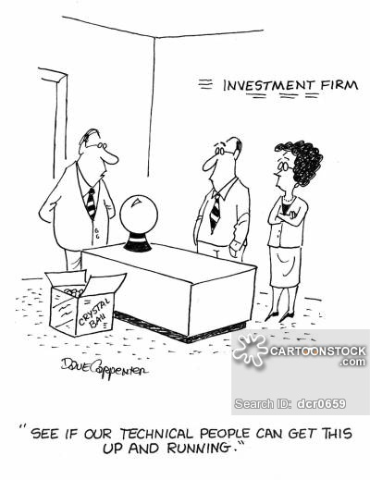
DATASET
Hotel_Address
Review_Date
Average_Score
Hotel_Name
Reviewer_Nationality
Negative_Review
Review_Total_Negative_Word_Counts
Positive_Review
Review_Total_Positive_Word_Counts
Reviewer_Score
Total_Number_of_Reviews_Reviewer_Has_Given
Total_Number_of_Reviews
Tags
Days_since_review
Additional_Number_of_Scoring
Lat & lng
The dataset contains 515,000 customer reviews and scoring of 1493 luxury hotels across Europe.
Data is originally owned by Booking.com.
The size of the dataset is ~227 MB

Slide 3

PROBLEM STATEMENT
MODULE 1:
Analysing reviews and recommending the hotel owner for areas of improvement
MODULE 2:
Auto Classifying a review as positive and negative by training the model with text review inputs
MODULE 3:
Visualisation of data for better insights and confident predictions

Slide 4
DATA PREPROCESSING
Uniform Data-(Lower case and whitespace removal)
Data filtering - Removing text that does not add value(Eg : “No negative”)
Stopwords- Customizing as per the data( addition of some stopwords and removing some)
Stemming
POS-tagging

Slide 5
SOLUTION - ALGORITHMS?
Input from User - Hotel Name
Output to user - Visual depiction of hotel’s performance
The positive review column is updated from considering both the positive and negative reviews using textblob.The actual positive comments are filtered Similar operation is performed for getting actual negative reviews
Wordcloud for user specific hotels-Filtering reviews based on hotel name
Wordcloud for best performing hotels-Considered 99 percentile by average score
Wordcloud for similar hotels in proximity-Measured distance and similarity is determined

Slide 6
SOLUTION - ALGORITHMS? CONT..
Auto Classifying a review:
Training the model with tagging the positive and negative reviews
Multinomial Naive Bayes
Logistic Regression
Support Vector Machine
The precision, recall and accuracy are calculated and the results are compared. Logistic regression is giving the best precision and accuracy among these 3 models.

Slide 7
SOLUTION - ALGORITHMS? CONT..
Visualisation of data for better insights and confident predictions:
Missing values of latitude and longitude(17 hotels) are replaced .The duplicate hotels are removed
Bar graph are generated by grouping the hotels according to the average score(X-axis) and the count of hotels(Y-axis)-Used MatplotLib
The top 10 hotels with most reviews are plotted and to analyse which hotel is more popular among reviewers
The locations are plotted as map using folium library to provide the user a better and intuitive way of data analysis

Slide 8

WHY?
For eliminating anomalies in positive and negative reviews textblob when considered with subjectivity and polarity is faring better
Implementation of multiple text classifiers gives us better insights
The visualisations which gives better insights over many are considered and implemented.So the owners would have clear idea about the market

Slide 9
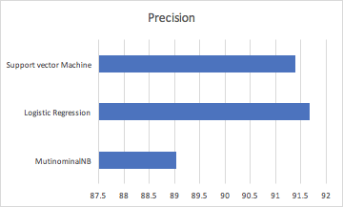
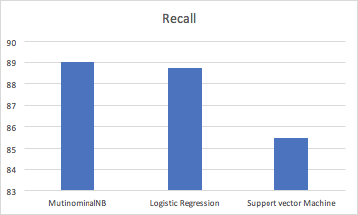
EVALUATE

Slide 10
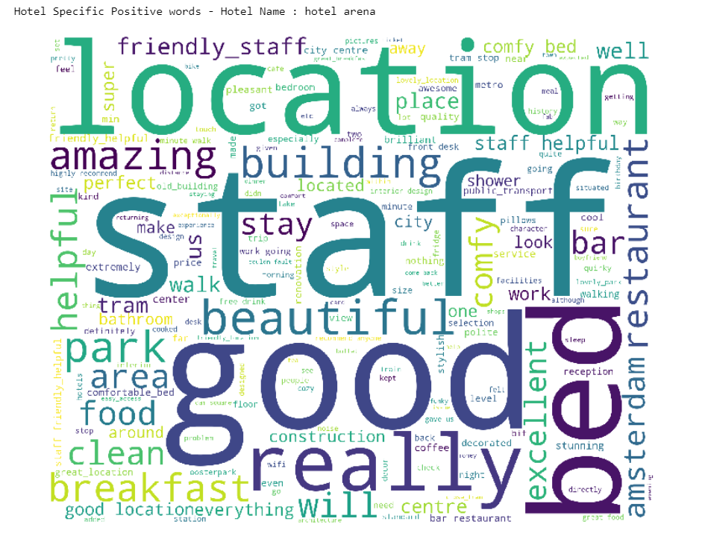
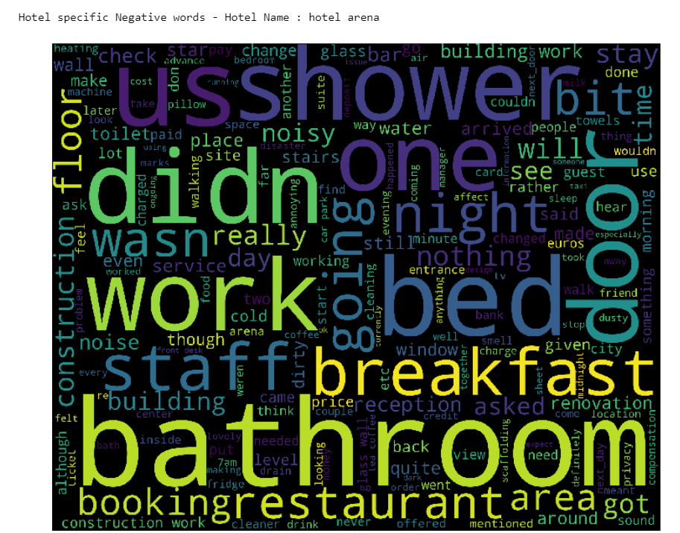
WORDCLOUD

Slide 11

Things that worked
The missing values in longitude and latitude column are filled with the values derived from the address.
After analysing various ways of data visualisation word cloud seemed to be better option rather over plain text.
Generating the word cloud for better performing hotels and most similar hotels would be very useful for the individual hotel owner.

Slide 12
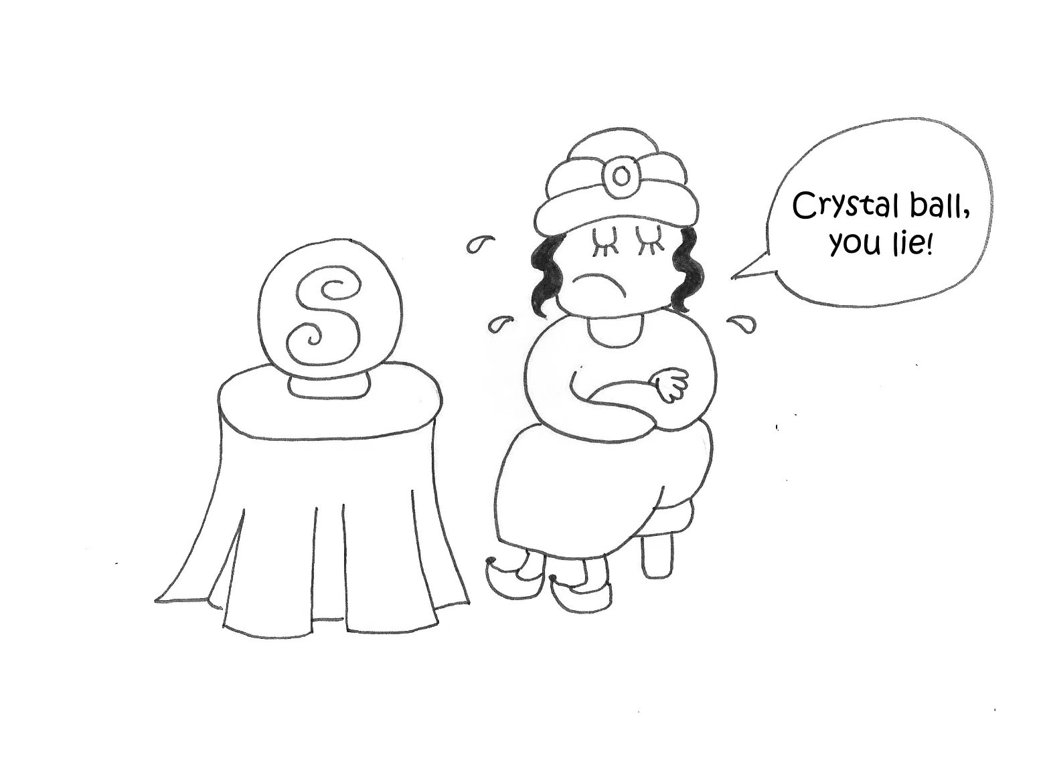
Things that didn't work
Opinion Mining for getting the important words and their positive and negative weights but it was not showing accurate results.
Tried getting the similar hotels considering the “Tags” but since each reviewer has tagged the trips differently, we had to drop the idea of taking this column into consideration for finding similarity.
The idea of accurately handling the positive and negative reviews is compromised to certain tradeoff owing to limitations with dataset.
Splitting a review into multiple sentences is not possible as there is no separate sentences in data set

Slide 13
THANK YOU

